Slide 1

Authorship Analysis for Arabic Texts Through Style Comparisons
Prepared By:
Qutaiba Olayyan
Eyab Ghifari
Supervised By:
Prof. Adnan Yahya

Slide 2
Introduction
The importance of authorship identification.
The impact of authorship identification on areas such as literature, and social media.
The Role of machine learning in authorship identification.

Slide 3
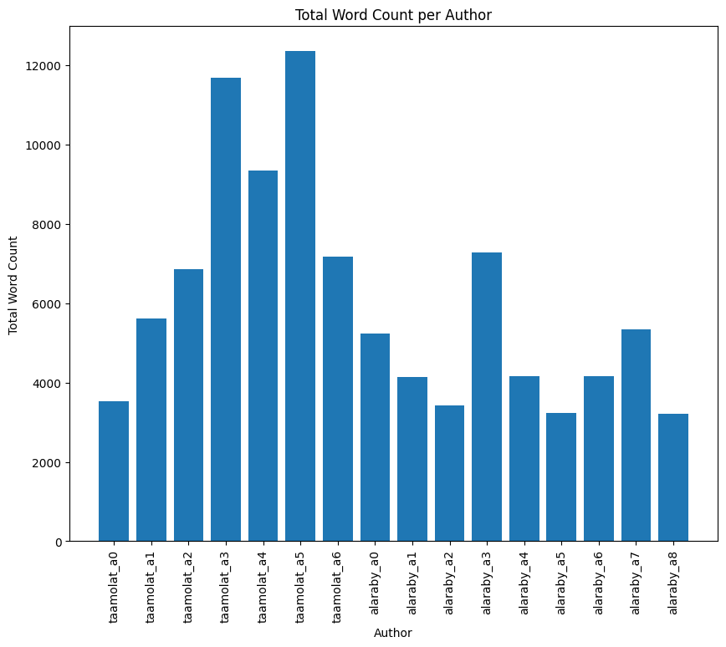
Methodology
Data collection
An Arabic author attribution dataset.
A Dataset for Arabic Author Identification.
http://www.taamolat.com
https://www.aljazeera.net/blogs
https://fada.birzeit.edu

Slide 4
Methodology
Preprocessing
Normalization
Tokenization
Arabic Stop Words
Stemming

Slide 5
Implementation
Feature extraction methods:
TF-IDF
Word Embeddings (FastText)
The different ML models used: Logistic Regression, Random Forest, SVM, KNN, and MLP.

Slide 6
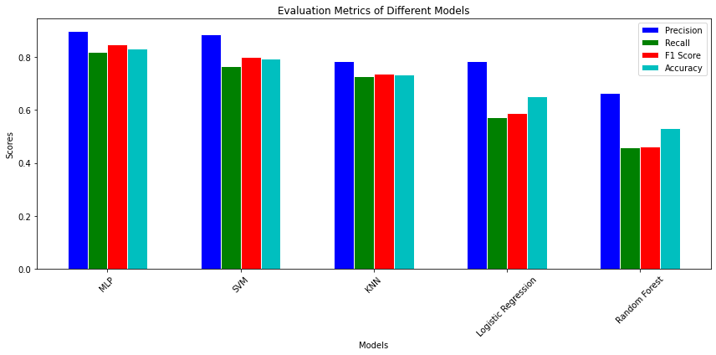
Model Performance Evaluation

Slide 7
Conclusion
Research used machine learning for author attribution in Arabic texts.
Used data collection, preprocessing, TF-IDF, and Word Embeddings techniques.
Achieved classification accuracy of ~84% and developed an authorship verification model.
MLP and SVM models were the most effective.
The study contributes to combating digital plagiarism.

Slide 8
Possible Improvements
Possible improvements for model accuracy enhancement.
Suggested improvement: pair-wise feature extraction methodology and Pos-Tagging.
Three potential pair-wise strategies:
Merge texts before preprocessing.
Preprocess each text separately before merging.
Preprocess and extract features from each text separately, then merge.
Part-of-speech Tagging.
Strategies could improve accuracy but need testing and validation.
Future work should explore these strategies for improved models.

Slide 9
Q&A Session:
Your Questions,
Our Answers

Slide 10
We hope you like our project!

